Slide 1
Identify the poetry style
Pay careful attention to how many syllables are in each line and how long the poem is.

Slide 2
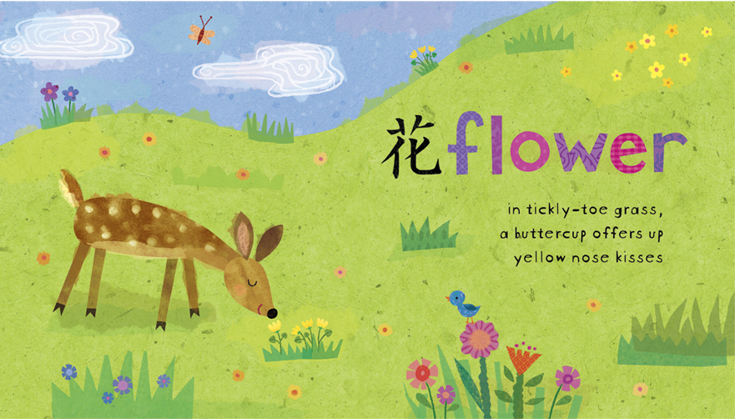
1. What is this style of poetry called?
Sonnet
Haiku
Free Verse
Rhymed Poetry
2. How many syllable are in each line?
5, 7, 5
What country does this style originate from?
Japan

Slide 3
1. What is this style of poetry called?
Sonnet
Haiku
Free Verse
Rhymed Poetry
2. How many syllable are in each line?
10
3. Which writer is famous for using this style?
Roald Dahl
J.K Rowling
William Shakespeare
4. How many lines are in a sonnet?
14

Slide 4
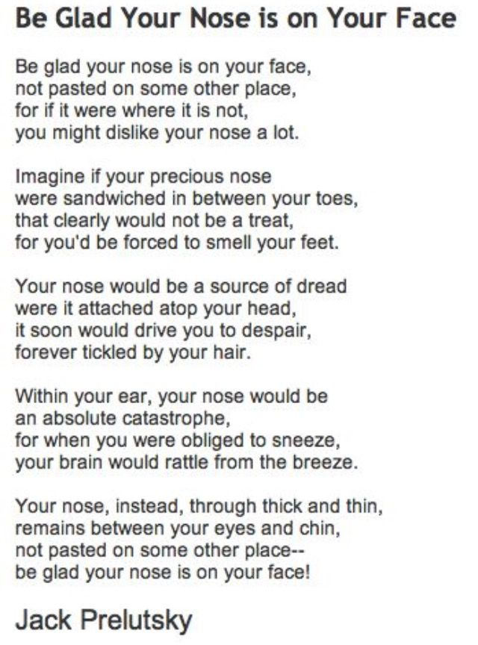
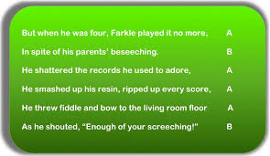
1. What is this style of poetry called?
Sonnet
Haiku
Free Verse
Rhymed Poetry
2. What are two lines that both rhyme called?
A pair of rhyming lines is known as a couplet. They also tend to be similar in length.
3. Is there only one rhyming scheme?
Rhymed poetry can use many different rhyme schemes.

Slide 5
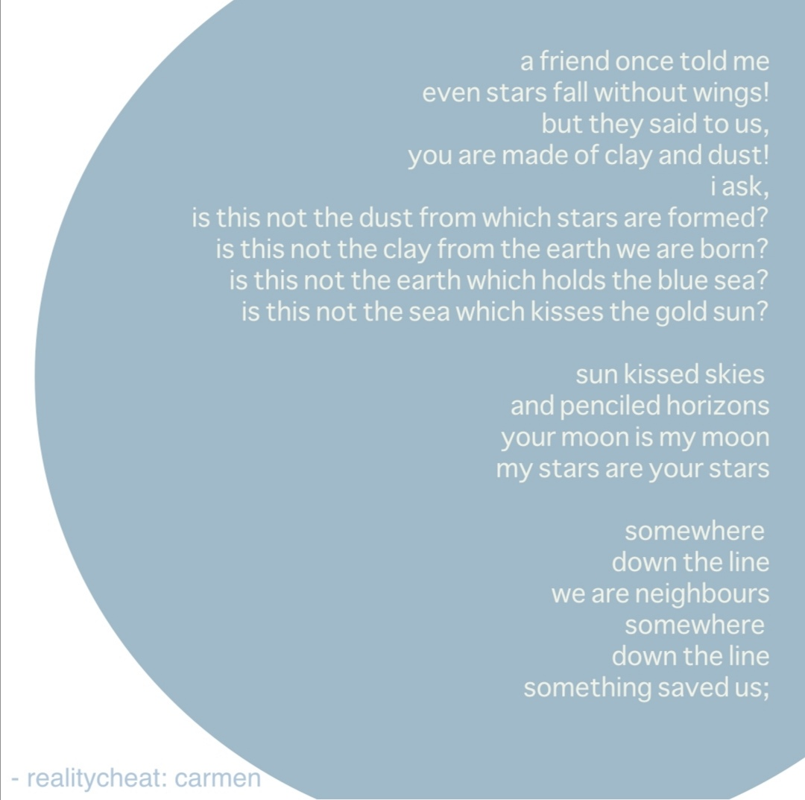
1. What is this style of poetry called?
Sonnet
Haiku
Free Verse
Rhymed Poetry
2. What are the rules of free verse poetry?
There are no rules.
3. Can free verse poetry rhyme?
Some free verse poetry can use rhymes however there are not set rhythm, patterns or rules.

Slide 6
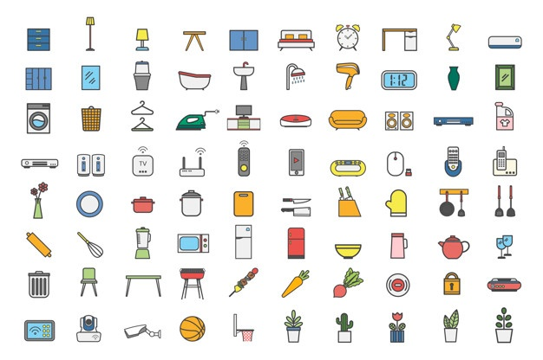
Pick a word
Think of your favourite word. If you don’t have one then pick something you can see.

Slide 7
Imagine that word was the name of a person
What would they look like?
Big or small?
What colour eyes would they have?
How old would they be?
Are they clever?
Are they clumsy?
What is their job?
What do they like to do for fun?
If you don’t want to write it down then you can draw your character instead!
Pay careful attention to the sound of the word.

Slide 8
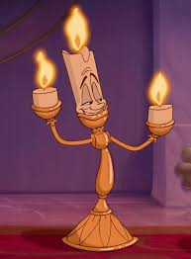
Making a poem
Without stopping, write a poem about that character in 1 minute. It doesn’t matter if you make mistakes. You can change it later.
A boy named Candle
Caused quite the scandal
Tall as could be
He radiated heat
Eyes bright as fire
Arms thin as wire
But he was rather clumsy
One grim day at the beach
He decided to take a dip
That’s when the big wave hit
He lost his shorts to the sea
Came out bare as a baby

Slide 9
Literary Techniques
Which is an example of:
Personification
Onomatopoeia
Alliteration
Crackle
Cute critter
The water banged angrily
Personification is when an inanimate object is given attributes or described in a way typically associated with humans.
Onomatopoeia is when a word’s phonetic sound resembles it’s meaning.
Alliteration is when a series of words begin with the same letter.

Slide 10
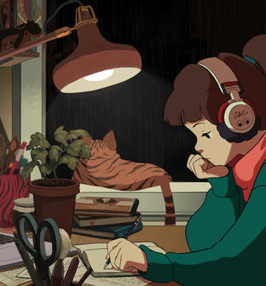
Rewrite your poem
First look over your poems and check for any mistakes or spelling errors
Think of ways you could re-write is or words you can change
Try put it in a different style (think of the types of poems we looked at earlier)
If it rhymes try a different rhyme scheme

Slide 11
Trying a new language!
Try translate the poem into the target language. Just do what you can for now. Don’t worry about making mistakes. You can change it later!

Slide 12
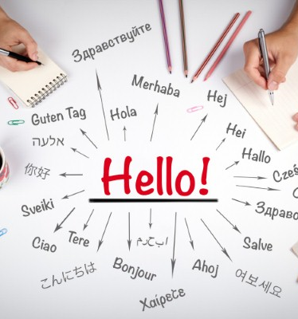
Writing in a new language
Using help from your teacher/the internet/a parent, try translate the rest of your poem
Does it still fit the style you originally wrote it in?
You may want to look up synonyms or change parts of it to make it flow better
Play around a bit and explore new styles
You can even choose a new word or character if you want
Be creative and have fun!

Slide 13
The Final Touches
Once complete: ask a parent/teacher/friend to check it for you and correct any mistakes
See if you can translate it back to English
Once this is done you can decorate it by drawing and adding images/patterns to your piece.

