Slide 1
Cinquains Workshop
Suitable for KS2/3

Slide 2
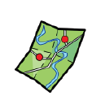
Pick a destination
Pick a destination, anywhere!
How are you going to get there?
What will you take with you?
What will you hear/see?
What will you be able to smell?
Notes:
Teacher notes
Purpose of this activity is getting children thinking about a county/city they would like to visit. Ask them to think about somewhere meaningful to them. This could be a country they previously lived in, a place where their family is historically from, a place that they have lived in that was different from a place they now live in etc.
Give them 5-10 minutes to discuss their ideas with a partner. Have them narrow in on their senses as they describe this place that they are talking about. If needed pause the session to remind them to narrow consider poetic devices they could use in their descriptions of their journey (e.g., alliteration, similes, metaphors, rich descriptive language)
Have they got some vocab in different languages that they could use in their descriptions? Or colloquial idioms that they can include in their note making?
Have class feedback of ideas, encourage students to magpie good ideas that their friends have shared. Encourage a collaborative approach as children can offer suggestions to elevate their friends idea.

Slide 3
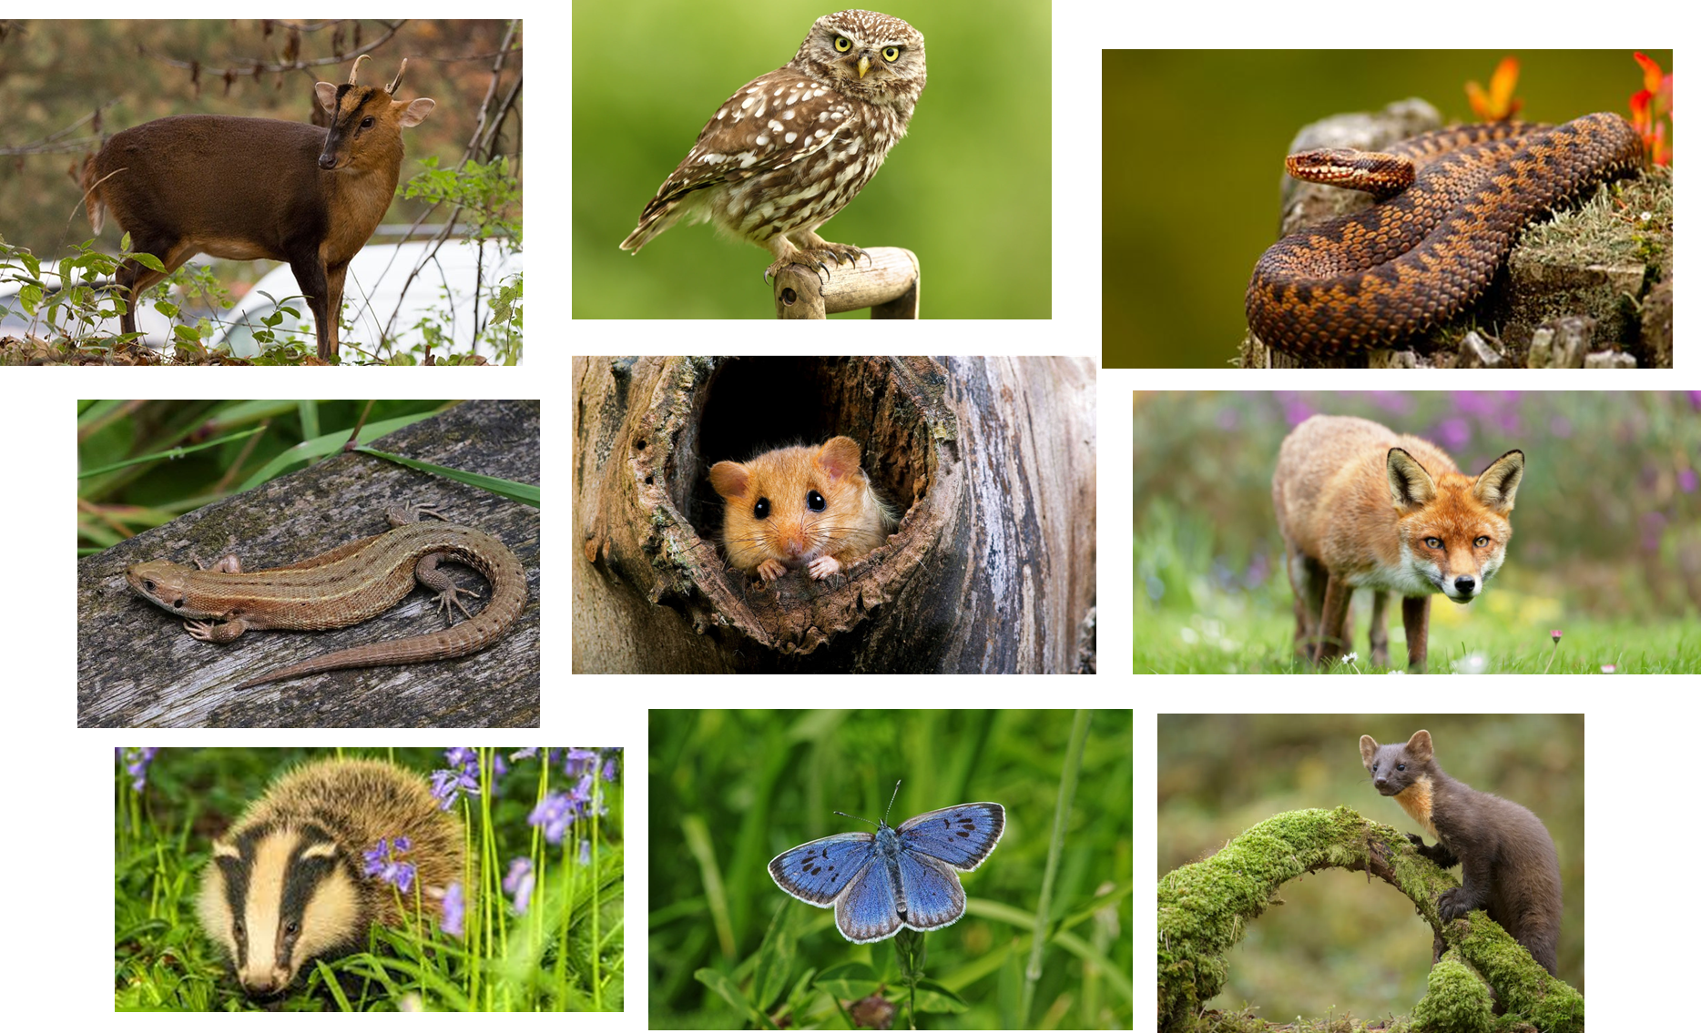
OH NO!
You have now been turned into an animal!
Notes:
Give children either pictures of animals or a sticky note with an animal on it. Explain that they are now an animal and must think about the journey they will now make as the animal.

Slide 4
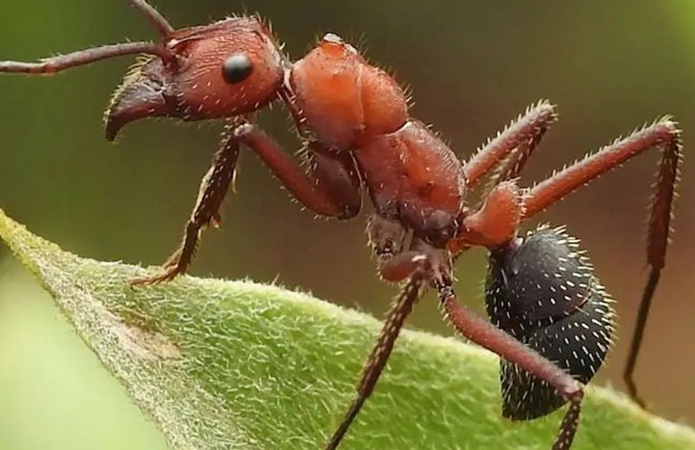
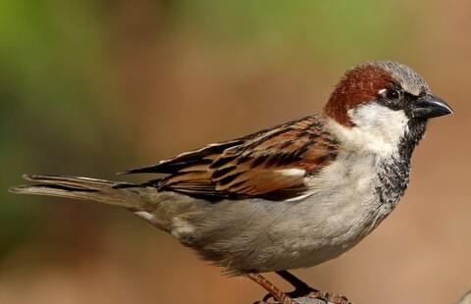
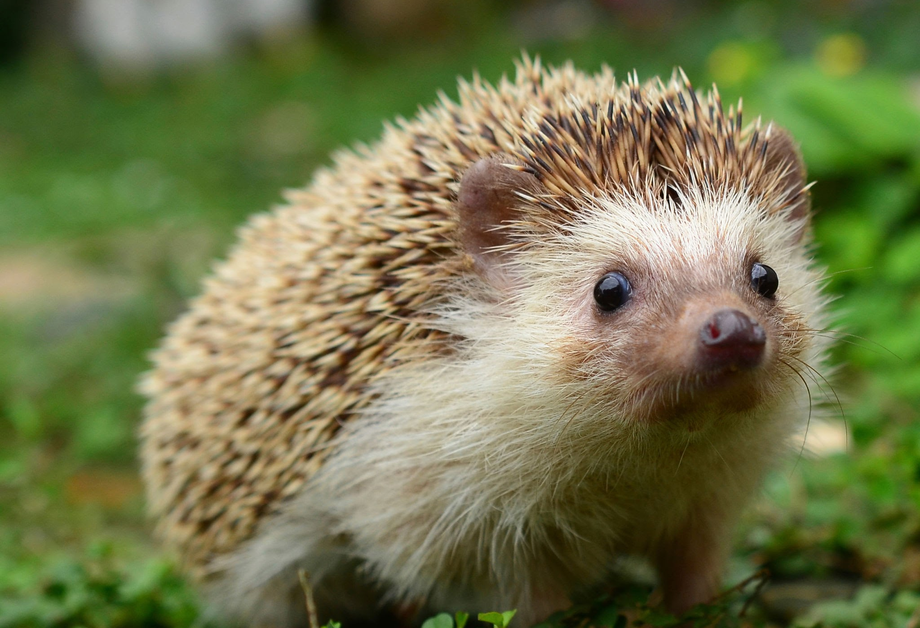
How does their journey now change? How will you get there?
What will you see if you are an animal?
Will you still take the same items?
Will you take the same person?
Notes:
Present children with pictures of animals give them 10 minutes to tweak their ideas and to imagine what they will see as an animal. If students are struggling allow the 5 minutes to try independently and then model how you would put yourself in the position of an animal.
E.g., if I was a hedgehog, I know that I would be small – everything will be bigger than me. I might see a puddle on the side of the road as a lake, a lake as an ocean. I could not get in car and drive – I would have to walk. I would walk through the countryside and the city. Or if I am already at the location, I might think about what I would see. E.g., a marketplace may no longer be a peaceful wandering activity but rather an obstacle court. Smells might be heightened.
How does their journey now change? How will you get there?
What will you see if you are xxx,
Will you still take the same items?
Will you take the same person?

Slide 5
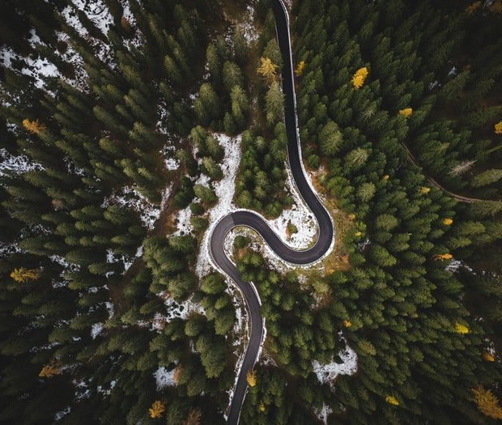
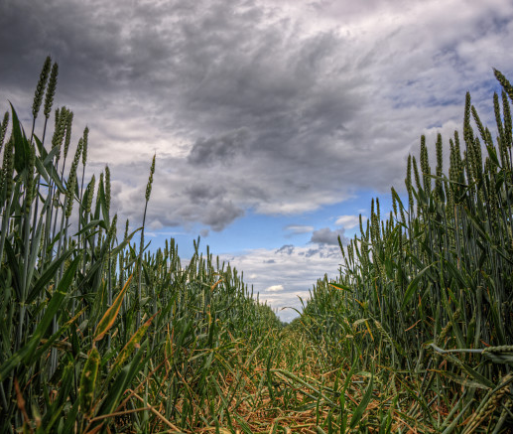
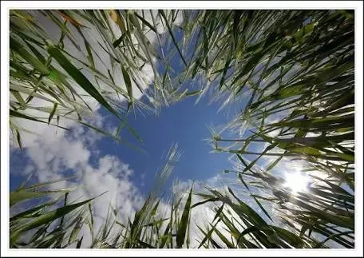
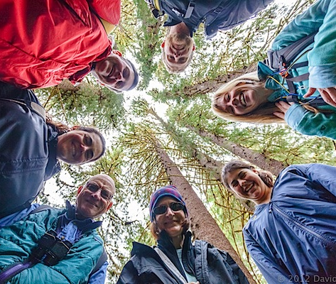
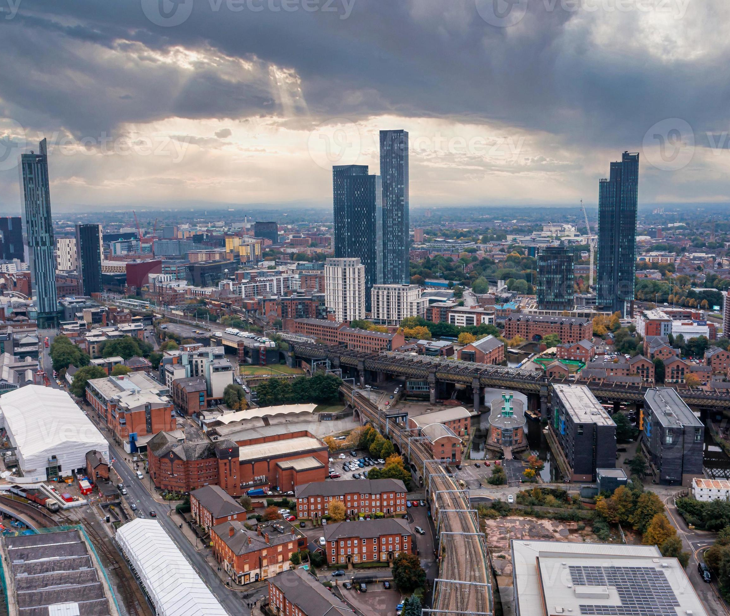
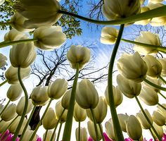
Notes:
Use these images to help children begin to understand perspective. If they were a bird everything could be below them. If they were an ant then even grass would seem like a swaying forest.

Slide 6
Think out the words to describe how you will travel, will you fly? Will you scuttle? How quick would you move?
What would you see around you, above you, below you?
Notes:
Once children have generated some ideas as to what their animal journey would be like move on and introduce them to how they are going to use these ideas in the poem they are going to write.

Slide 7
Cinquains is a French type of poetry and are a form of syllabic poetry characterised by a distinctive 5-line structure:
Cinquains

Slide 8
1st line: Noun
2nd line: Adjective 1, adjective 2
3rd line: Present participle, present participle, present participle
4th line: Four-word phrase
5th line: Closely related noun or synonym
1st line: 2 syllables
2nd line: 4 syllables
3rd line: 6 syllables
4th line: 8 syllables
5th line: 2 syllables
Notes:
Cinquains are a form of syllabic poetry characterised by a distinctive 5 line structure: The ‘hot’ challenge is the truest form of the poem but can be tweaked to make it easier for students (see medium challenge). Choose whichever best suits your cohort or provide children with both options for them to choose.

Slide 9
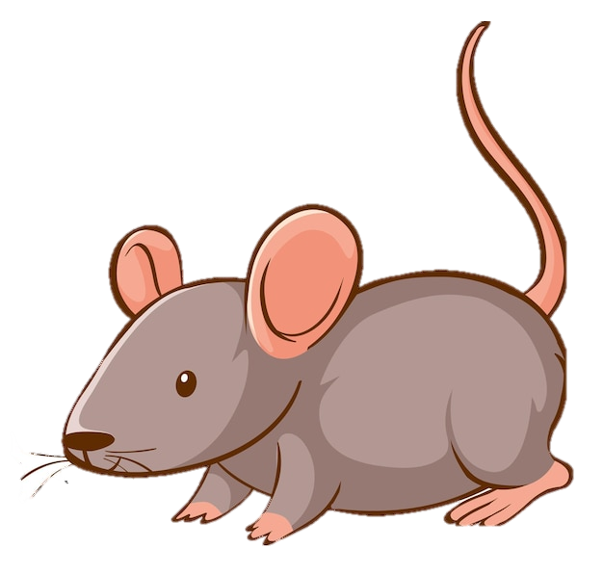
Scuttling (2)
Through cobblestone (4)
From England to France's realm (6)
Tiny paws seek adventurers’ path (8)
Nose-quiver (2)
Tunnels (2)
Low moonlit earth (4)
Mysteries waiting silent (6)
Whispered tales of cheese and croissants (8)
Ears-twitch (2)
Homeward (2)
With heart of tales (4)
Through fields, across the sea (6)
Memories of France's grandeur (8)
Deep still (2)

Slide 10
Translating
Now you have your poem in one language, try to translate it into another language. Don’t worry if you make a mistake, it can be edited later.
Does it fit the original style of your poem?
You may need to look up synonyms to help with the flow of your poem.
You may need a bilingual dictionary to help with translation.

Slide 11
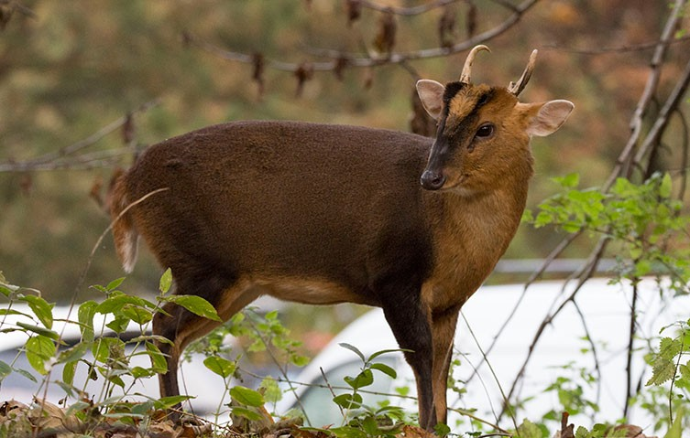
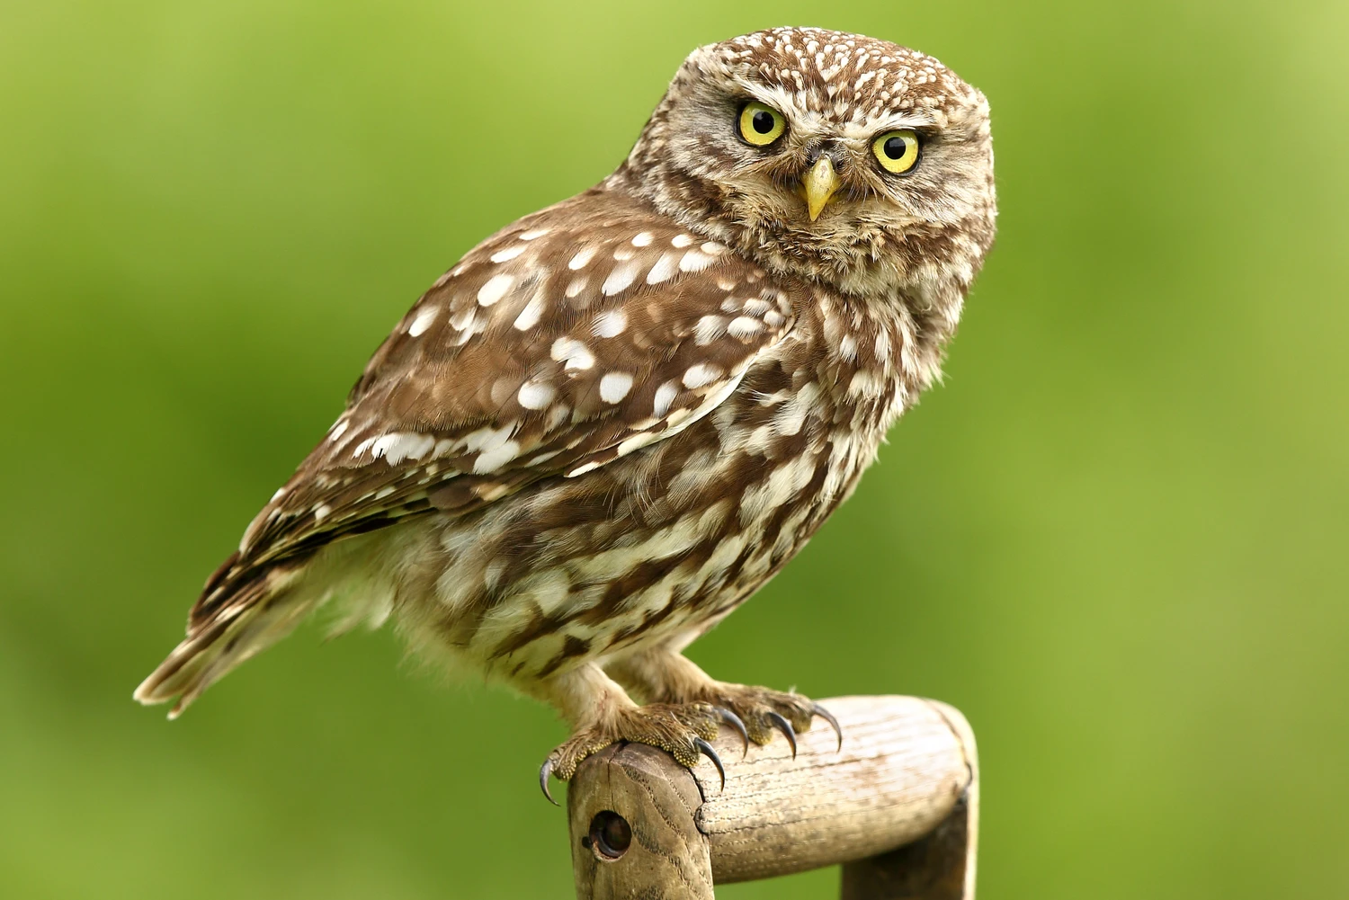
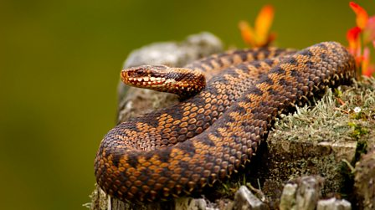
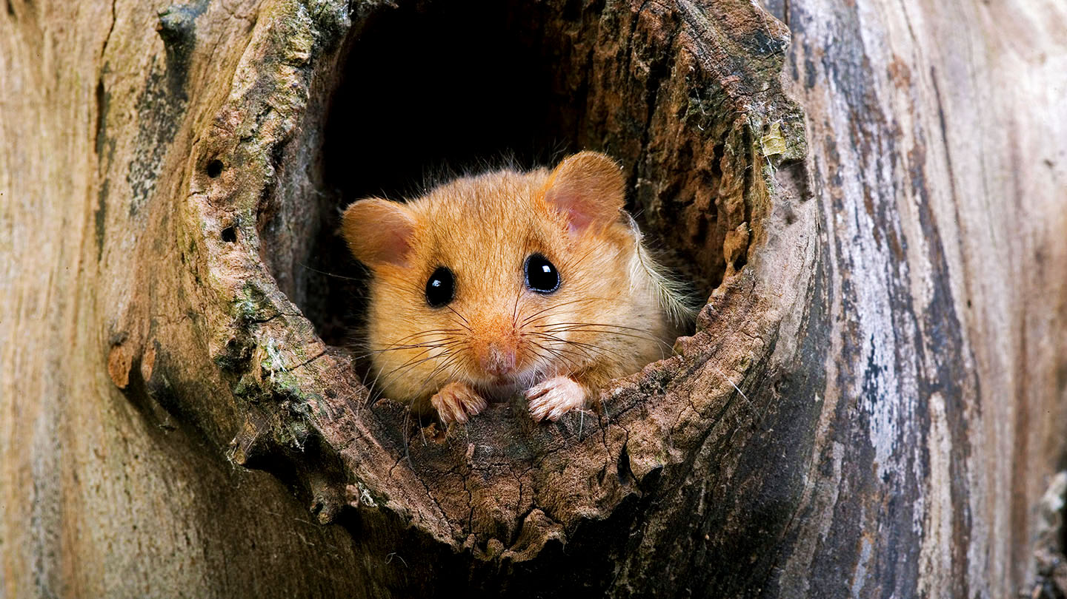
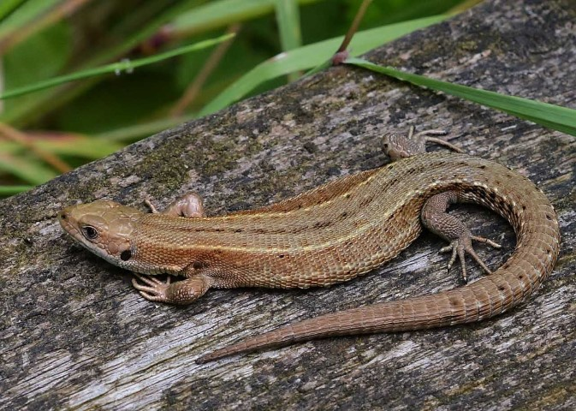
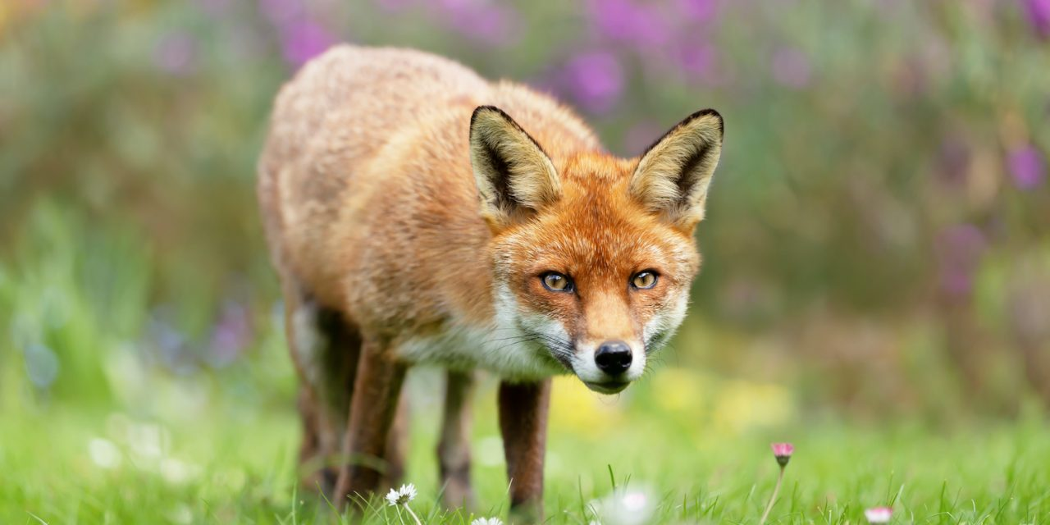
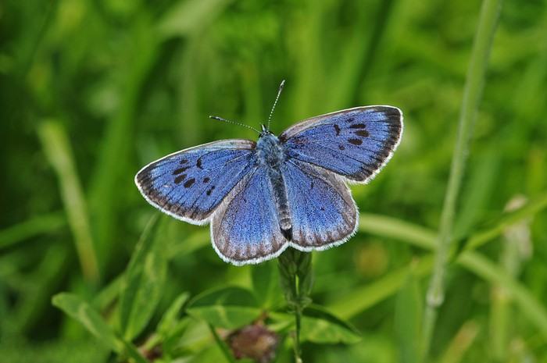
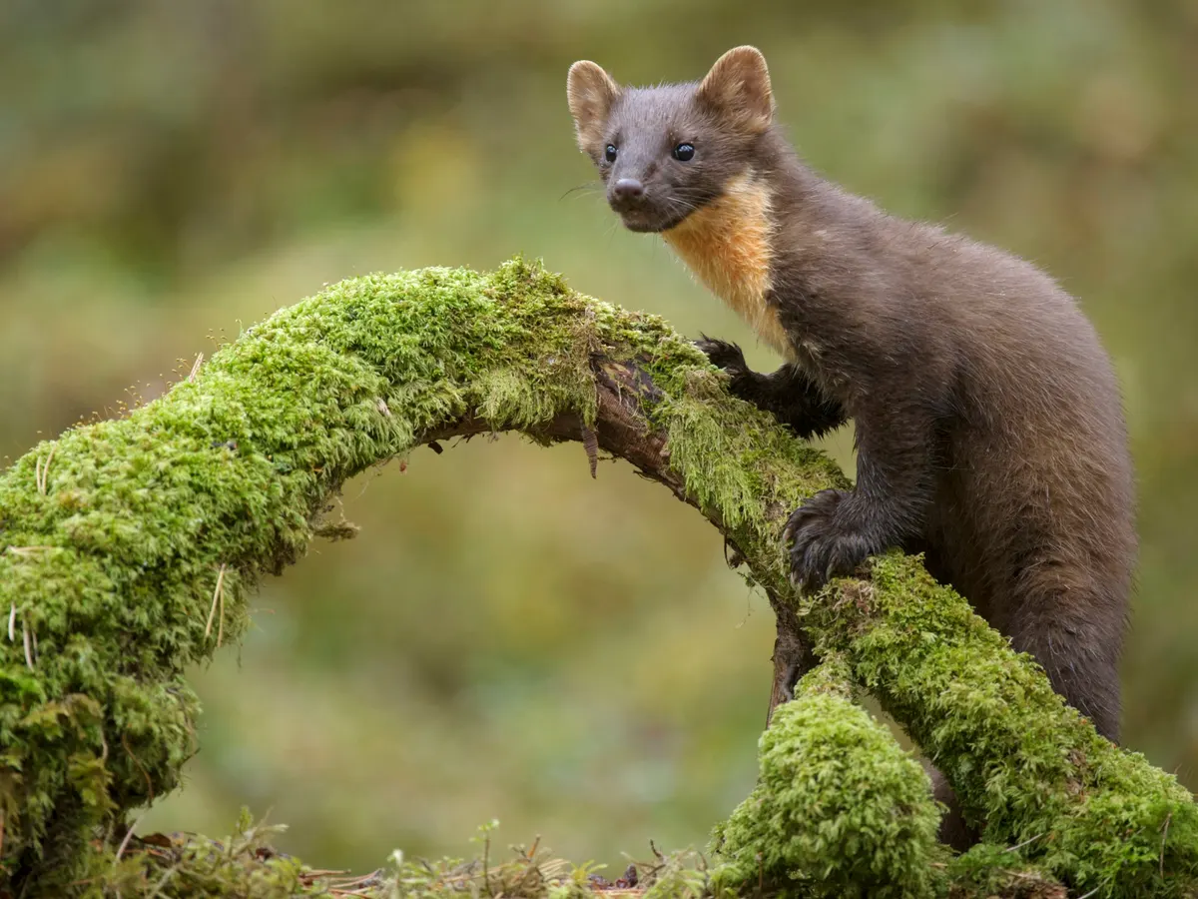
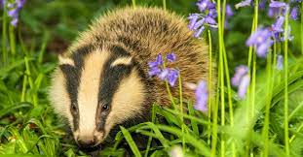
Notes:
Images left here for you to print if needed. You could present children with a post it note of the animal they are to think of.

