Slide 1
Working with Archives
4 March 2016
Dr David Sutton
Editor of the UK Location Register
Diasporic Literary Archives P.I.
Chair of GLAM
Chair of ICA Section on Archives of Literature & Art
Fran Baker
Archivist, The University of Manchester Library
Notes:
FB

Slide 2
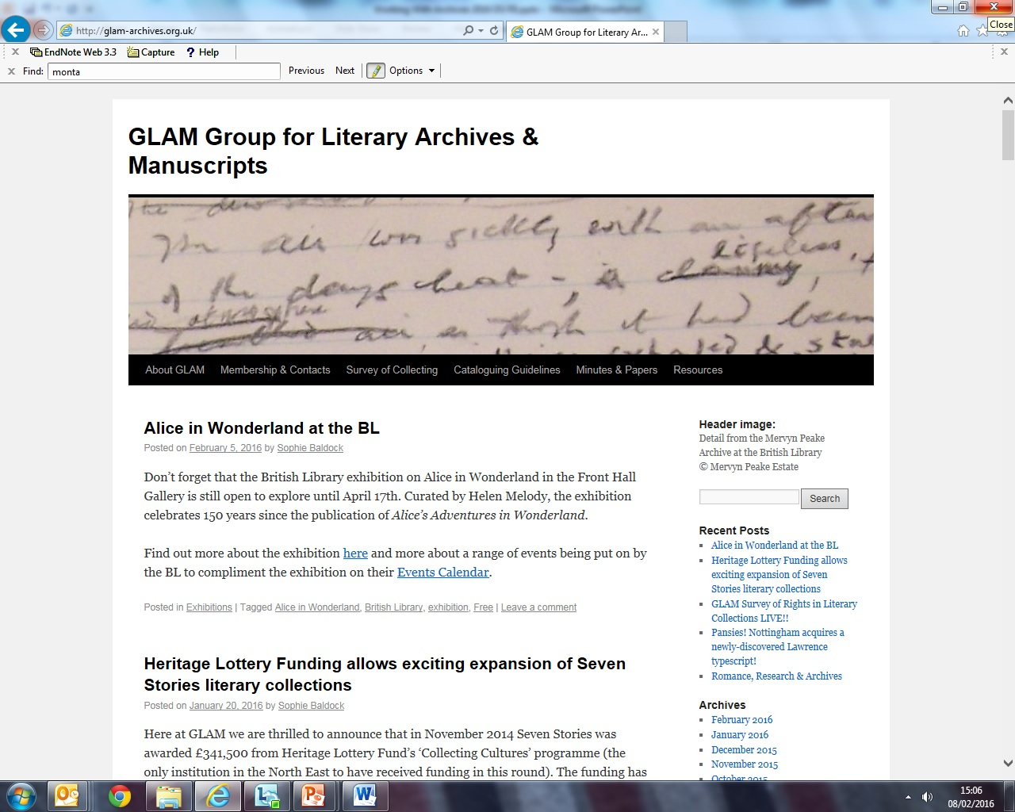
Notes:
FB

Slide 3
What is an archive…?
‘A body of documents (in any form or medium) which were created or received, accumulated and used by an individual or institution during the course of their daily activities and functions, and which have been preserved for their continuing value’.
Notes:
FB

Slide 4
Key characteristics
Primary evidence – not created with benefit of hindsight
Uniqueness – either individual documents or as an aggregation
Notes:
FB

Slide 5
Core archival principles
Provenance – don’t mix the archive of one creator with that of another
Original order – reflecting creator’s arrangement of their documents
Notes:
FB

Slide 6
Heather MacNeil, ‘Picking Our Text: Archival Description, Authenticity and the Archivist as Editor’
‘The traditional textual critic’s efforts to restore a text as closely as possible to its original, authentic form mirrors the archivist’s efforts to identify and represent the original order of a body of records through arrangement’.
American Archivist, 68:2 (Fall/Winter 2005), pp. 264-78
Notes:
FB

Slide 7
Catherine Hobbs, ‘The Character of Personal Archives: Reflections on the Value of Records of Individuals’
‘…working with the archives of individuals reminds us not just of the way that the individual fits into society, but the way in which many individuals work and construct their vision of their world in many ways on their own or for a major part in solitude’.
Archivaria, 52 (Fall 2001), pp. 126-135
Notes:
FB

Slide 8
Literary archives: distinctive characteristics
Cultural appeal
‘Magical’ as well as ‘meaningful’
Commodity value as well as research value
Private collectors and collecting institutions
Insight into the act of creation
Written word as process and product
Notes:
FB

Slide 9
Literary archives: what do they contain?
Literary manuscripts:
Rough notes and jottings
Manuscripts and typescripts
Annotated proofs
Correspondence:
Literary
Business
Diaries:
Personal
Engagement
Audio-visual material:
Photographs
Printed material:
Cuttings
Objects:
Pens
Personal
Typewriters
Locks of hair…
Films
Audio recordings
Annotated books
Journals
Notes:
FB

Slide 10
Diasporic Literary Archives Network
Università di Pavia
Fondo Manoscritti
Collecting Institutions in Trinidad & Tobago
Beinecke Rare Book & Manuscript Library
Librarians
Authors
Manuscript Dealers
Society of Authors
Publishers
Archivists
Literary Agents
Academics
UNESCO
Biographers
Notes:
DS

Slide 11
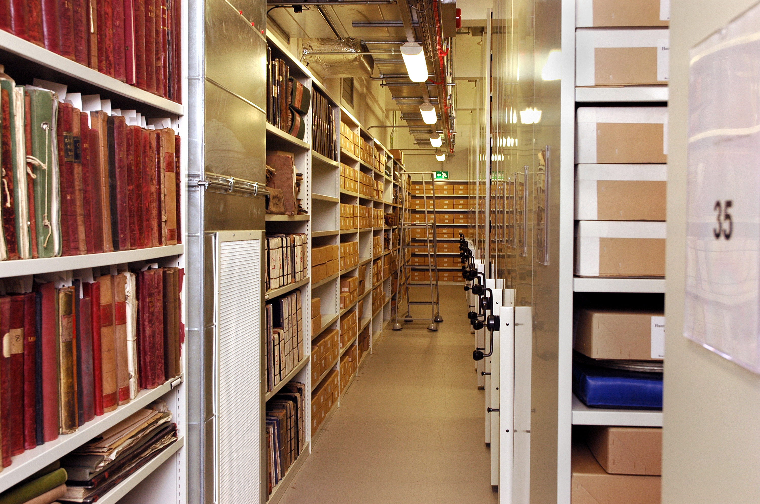
Collecting Literary Archives
Collecting Considerations:
Availability
Value
How much space? 
Why this author?
Collecting policies
Is this author “literary”? What about writers of children’s stories, or crime fiction?
Do we want to collect digital at this point?
Notes:
DS

Slide 12
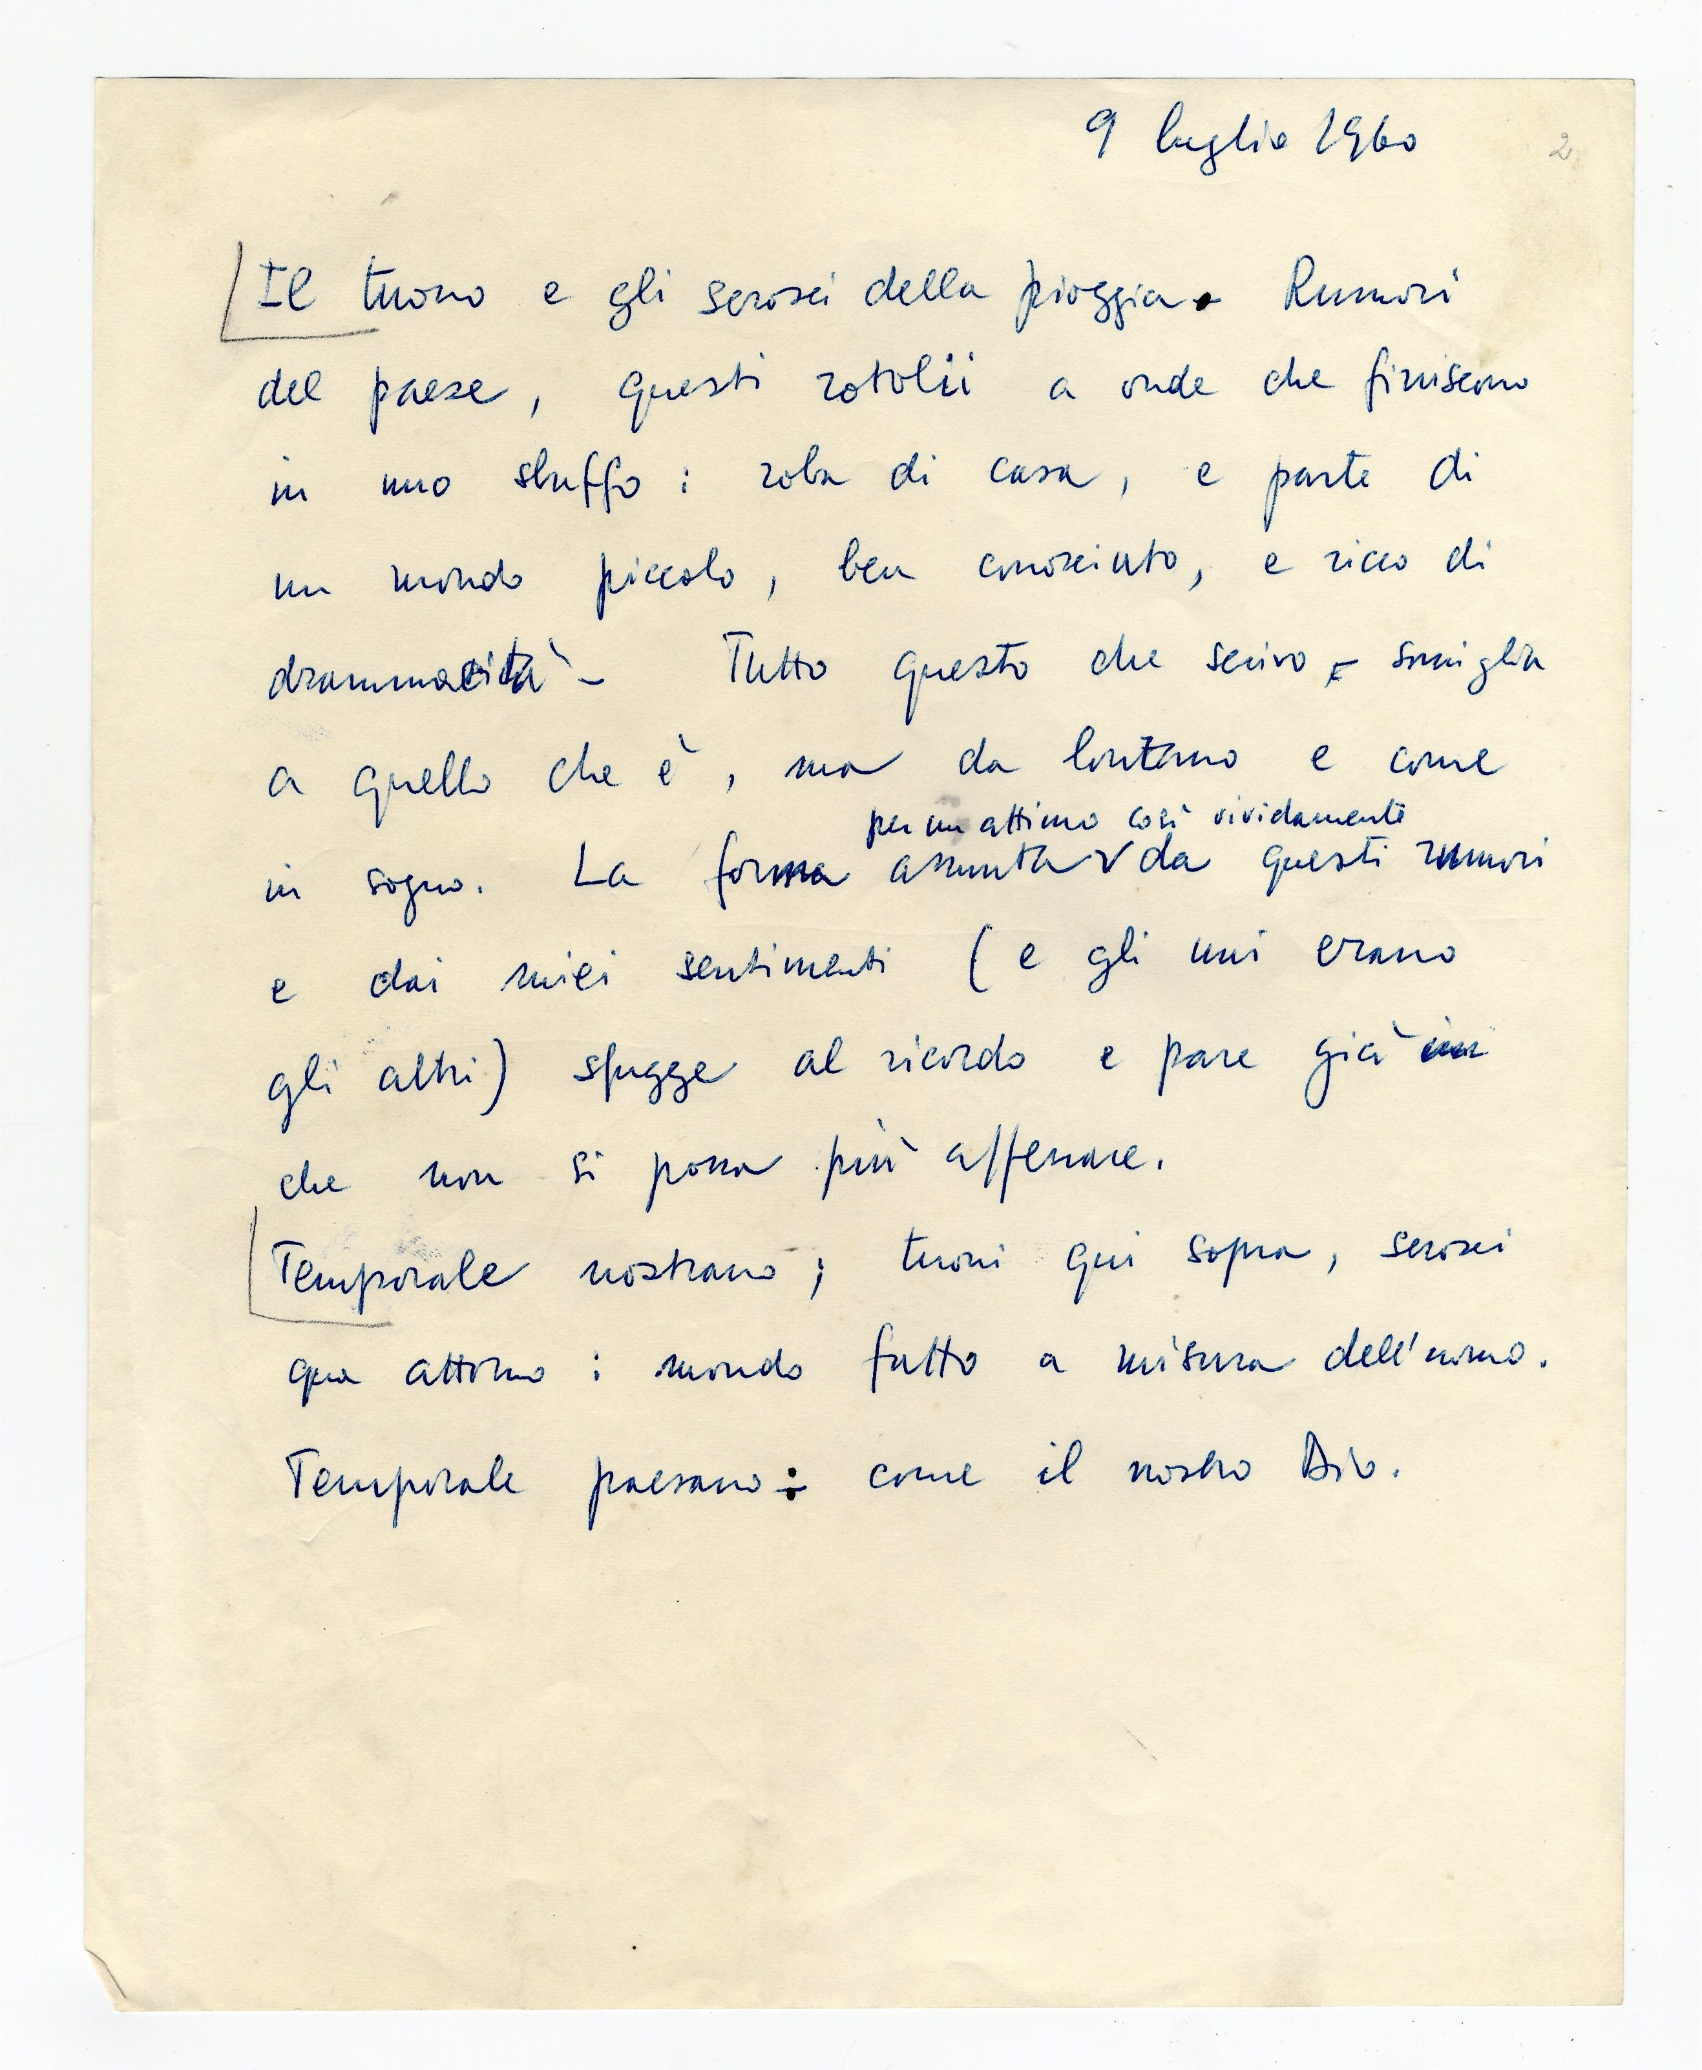
Collecting literary papers: some international examples, good and bad
France
Brazil
Trinidad & Tobago
Singapore
Nigeria
Namibia
Notes:
DS

Slide 13
Principles and ethics of collecting
Collecting policies
Who collects what? Why?
How many institutions?
Libraries or archives?
Centrally controlled? A national policy? Or a free market? The role of GLAM in the UK, and the idea of “appropriateness”.
Notes:
DS

Slide 14
Collecting Strategies: general principles
By pre-eminence
By research specialism
By region, city or island
By genre
By association or connection
By single author
Or by group of authors
By “hub and spoke” approach
By reference to a colonial past
By serendipity
Notes:
DS

Slide 15
Acquiring Literary Papers: methods
Donation by the author
Donation by family or friends
Bequest
Deposit
Permanent loan
Temporary loan
Private purchase
Purchase from a dealer
Purchase at auction
Notes:
DS

Slide 16
Acquiring Literary Papers: principles
The need for a contract
Specifying care and storage
Specifying any restrictions on access
Specifying the copyright position
Any flexibility on right to make copies?
Giving a cataloguing timetable
Weeding (not usually permitted with literary collections)
Digitisation?
Whose arrangement?
Notes:
DS

Slide 17
Working with authors 1
What do literary authors want?
Quality of storage
Prestige and recognition
Posterity
Usage and study
Sometimes payment
The literary archive is sometimes a personal pension fund
Taking authors on tours of the stacks
Notes:
DS

Slide 18
Working with authors 2
Helping literary authors
What should they keep?
How should they keep it?
When to transfer
Transfer in tranches
Access for the author
The document entitled Authors and their Papers
Notes:
DS

Slide 19
Cataloguing Literary Papers
Levels of cataloguing
Summary lists first
Collection-level; box-level; folder-level; item-level
Pressure to make available, especially purchased collections
Catalogues and indexes
Name indexes are very important for personal papers
Need to distinguish between creator and person mentioned
Scale
“Correspondence of Neshani Andreas” is too vague
Indication of number of documents and their significance
Cataloguing blogs
Spreading the word about new acquisitions which are being processed; letting people know when collections will become fully available
Notes:
DS

Slide 20
Locating Literary Papers
Reference books and Location Registers
www.locationregister.com
French location register
Artists Papers Register
British Book Trade Archives
Notes:
DS

Slide 21
Using Literary Papers: scholarship
Scholarly study of drafts and versions
Manuscripts are the basis of literary study
New emphasis on “collections-based research”
Literary criticism
Critical work which uses primary sources is deemed
superior
Literary biography
The importance of correspondence
Where does the archivist’s role end and give way to the biographer’s?
Notes:
DS

Slide 22
Using Literary Papers: copyright
Copyright permissions
Legislation is national
Different legislations in every country in the world
EU moving towards standardisation
Duration of copyright
The European 70-year post mortem norm
Countries with longer durations (USA, Mexico, Ivory Coast)
Countries with shorter durations (South Africa, India)
Countries with copyright extensions (France, Spain, and … )
The UK copyright anomaly for manuscripts
Distinction between “published” and “unpublished” in UK law
Copyright in older manuscripts enduring until 31 December 2039
Notes:
DS

Slide 23
Ethics: archival responsibilities
Archivist
Archive
Archive creator (e.g. writer)
Executor/s
Writer’s family
Researchers
Data subjects represented in archive
Employing institution
See Archives and Records Association website for more on ethical issues - http://www.archives.org.uk/about/ethics.html
Notes:
FB

Slide 24
UK Data Protection Act 1998: Personal Data
Data relating to a living individual who can be identified:
from those data; OR
from those data and other information in possession of, or likely to come into possession of, the data controller
Notes:
FB

Slide 25
Sensitive Personal Data
Personal data consisting of information re:
Racial/ethnic origin
Political opinions
Religious or similar beliefs
Trade union membership
Physical or mental health
Sexual life
Commission/alleged commission of any offence
Any proceedings for any offence committed/alleged to have been committed
Notes:
FB

Slide 26
Exemption for research, history & statistics (s.33)
Must abide by the ‘relevant conditions’:
The data are not processed to support measures or decisions with respect to particular individuals;
The data are not processed in such a way that substantial damage or distress is, or is likely, to be caused to any data subject.
Notes:
FB

Slide 27
Personal data in literary archives
Diaries, letters – potentially thousands of data subjects
Blurring of boundary between public and private. Publisher’s editor: ‘lots [of sensitive personal data] but it also forms the subject matter of most of the poetry we publish!’
Notes:
FB

Slide 28
Managing Data Protection
Screening and making closures at point of cataloguing
‘Restricted’ status, and screening takes place when a researcher requests files to consult
Notes:
FB

Slide 29
Born-digital
Textual documents (Word, PDF etc) including literary drafts
Email
Financial material - spreadsheets
Photographs
Video
Audio
Websites
Blogs
Social media accounts
Notes:
FB

Slide 30
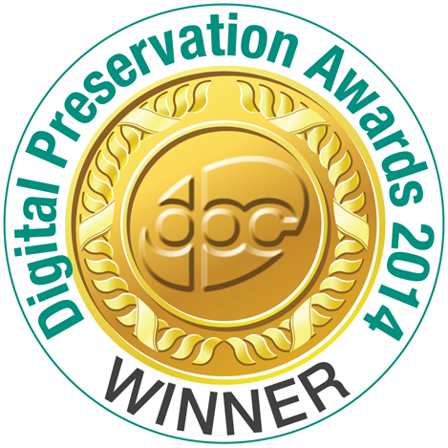
Email Preservation Project
215,220 email messages
65,594 file attachments
Correspondence of over 14,000 people
Spanning 12 years
Notes:
FB

Slide 31
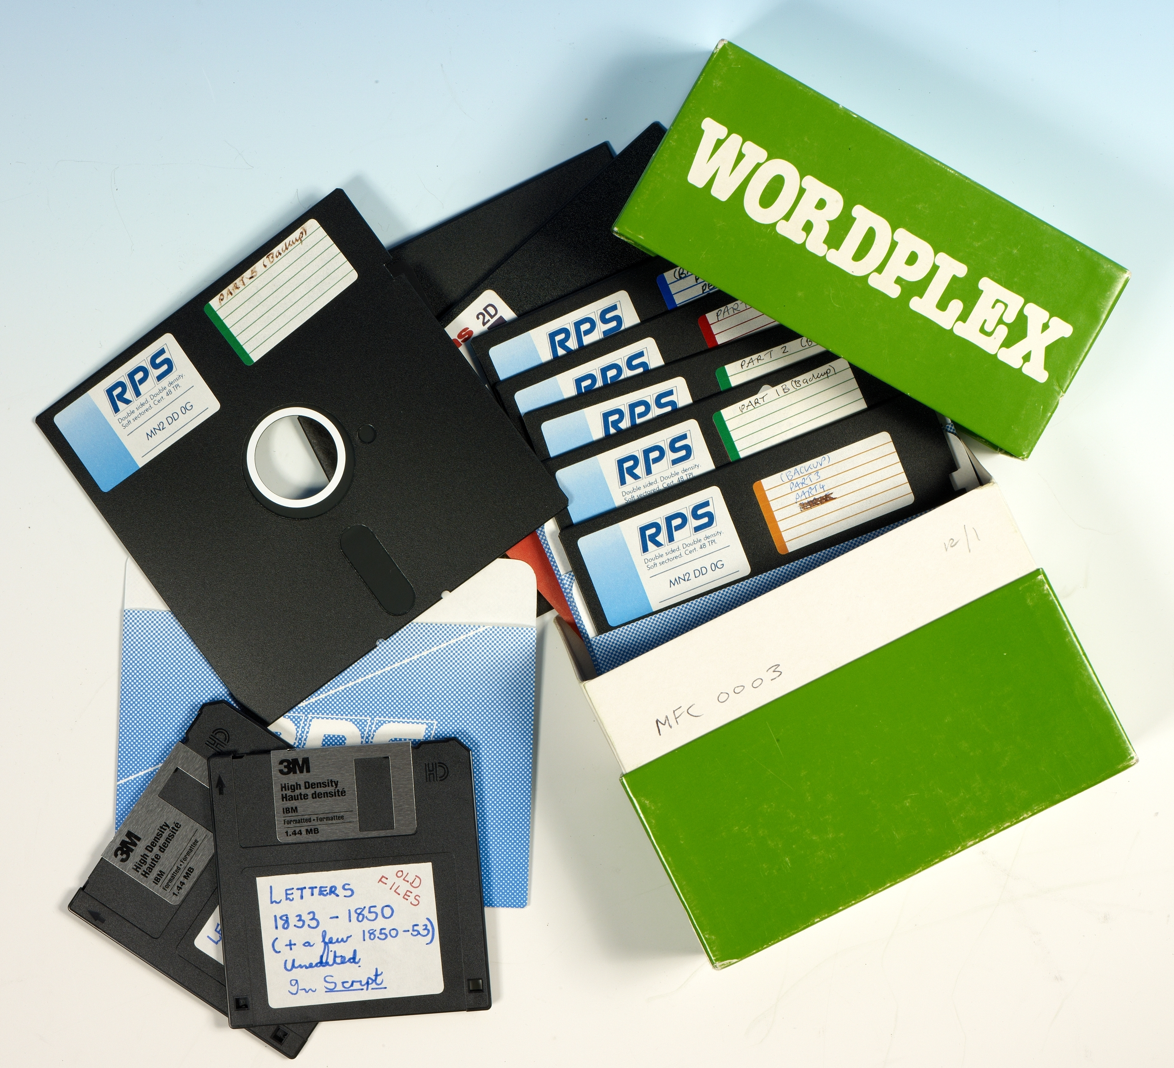
Born-digital: early intervention
Obsolescence – new versions of software, material saved on old media
Loss – storage on disks, USB sticks
Corruption – viruses
Over-writing of versions
Notes:
FB

Slide 32
Born-digital: authenticity
Notes:
FB

Slide 33
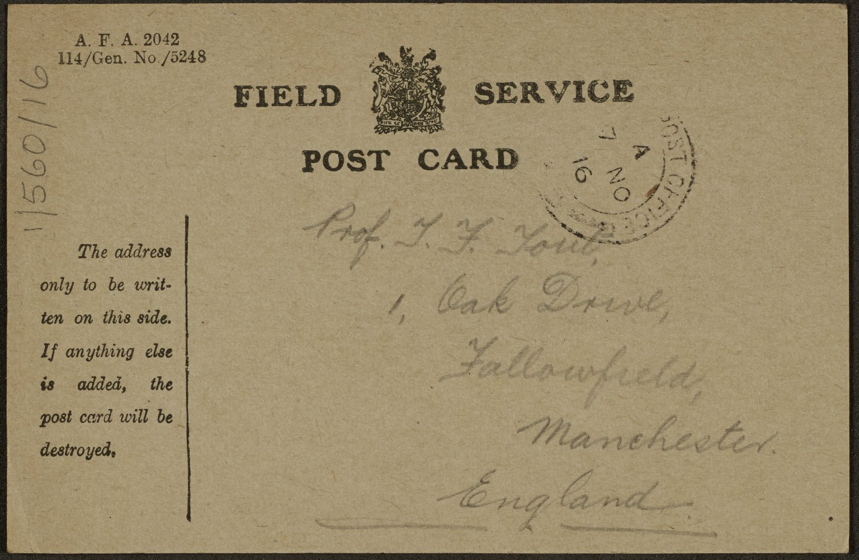
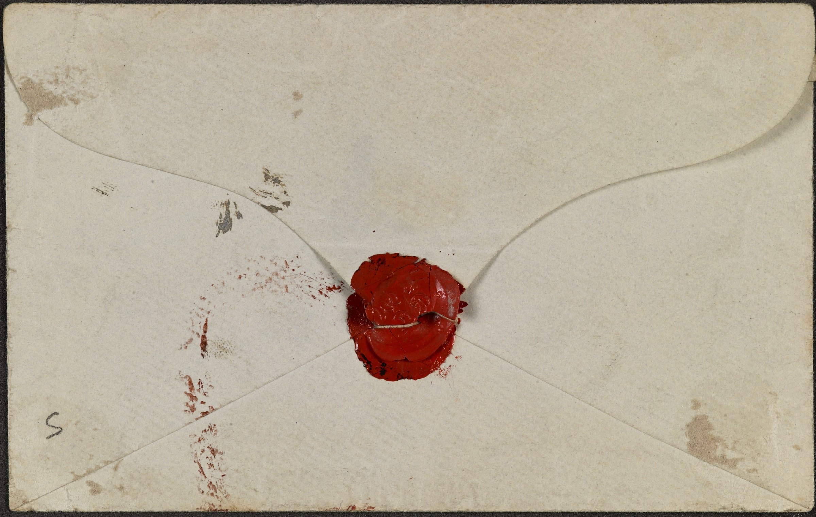
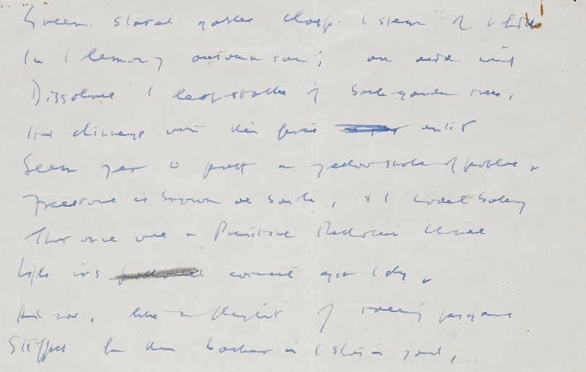
Authenticity: Diplomatics
Notes:
FB

Slide 34
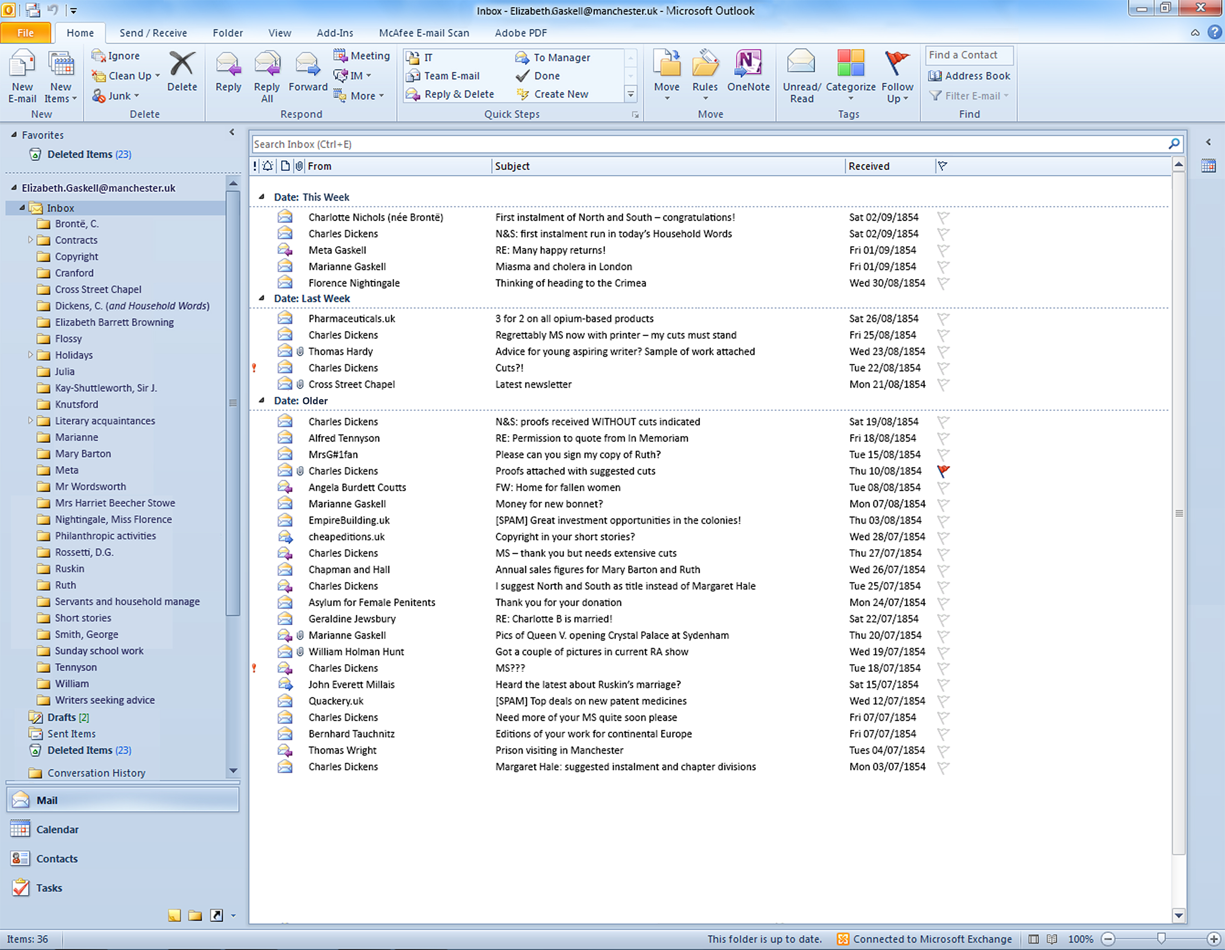
Digital diplomatics: ‘Significant properties’
For email:
Header information – for provenance and context
Attachments
Unusual fonts
Use of colour and/or highlighting
Layout – e.g. centring and line breaks (for poems)
Emoticons
Special characters
Embedded images
Notes:
FB

Slide 35
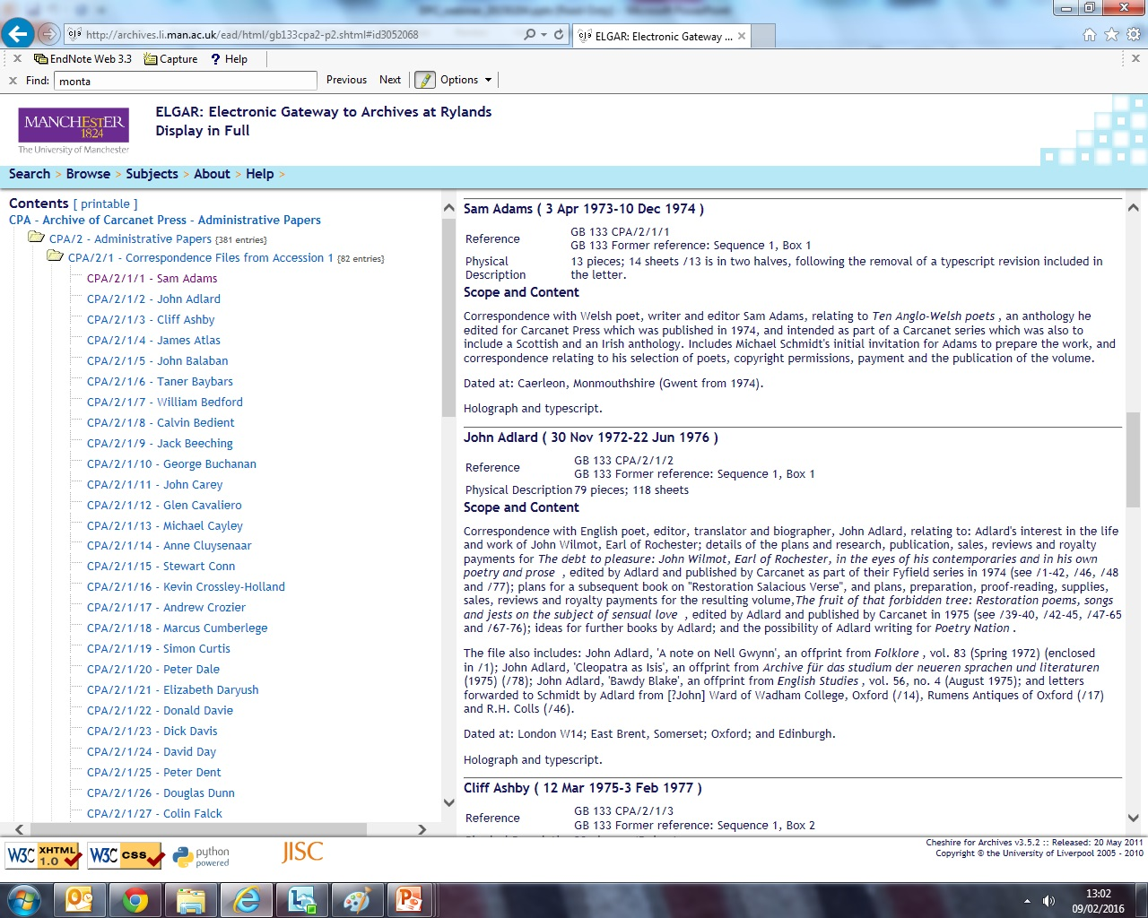
Notes:
FB

Slide 36
Notes:
FB

Slide 37
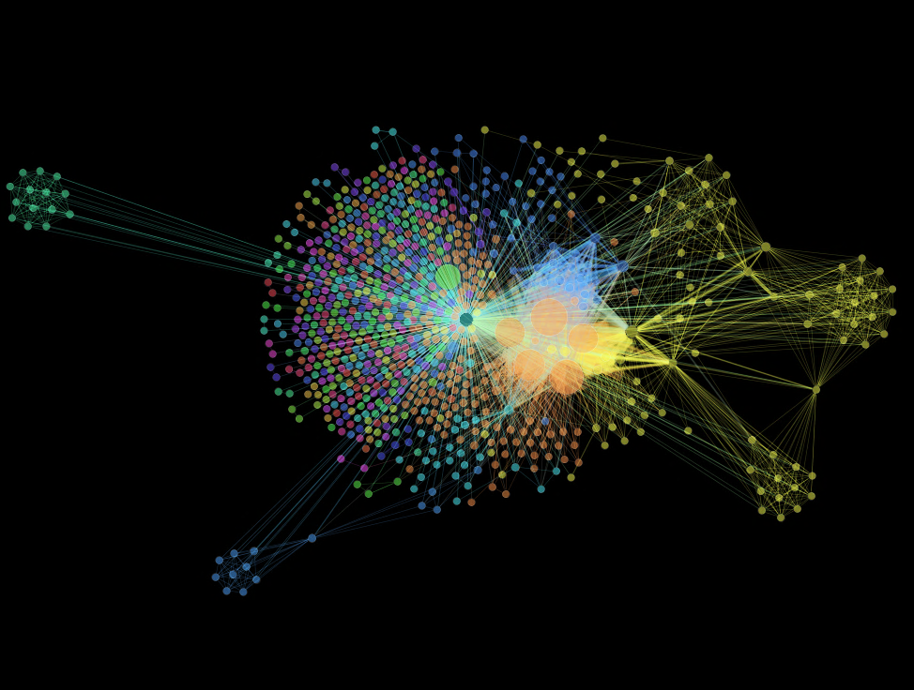
Notes:
FB

Slide 38
Questions
fran.baker@manchester.ac.uk
d.c.sutton@reading.ac.uk
http://glam-archives.org.uk
Funded by a grant from
www.library.manchester.ac.uk/special-collections
www.diasporicarchives.com
Notes:
FB/DS

